Slide 1
Panel 1: What are Nature-based solutions, offsetting and financialization? What is at stake?
Frédéric Hache

Slide 2
I
What are nature-based solutions?
European Commission definition
“Solutions that are inspired and supported by nature, which are cost-effective, simultaneously provide environmental, social and economic benefits and help build resilience.”

Slide 3
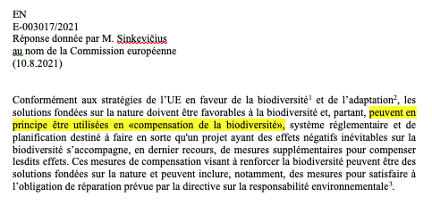
II
OFFSETTING IS PART OF NATURE-BASED SOLUTIONS
2016 IUCN World Conservation Congress
“It is IUCN’s position that biodiversity offsets can contribute to positive conservation outcomes (…) In some circumstances, where there is good scientific justification, it could be appropriate for the offset to conserve a different kind of biodiversity which is of higher conservation priority than the type affected (‘like-for-like or better’).”
European Commission
2020 IUCN Global standard for Nature Based Solutions
Criterion 3: NbS result in a net gain to biodiversity and ecosystem

Slide 4
III
NATURAL CAPITAL: THE ALLEGED MONETARY VALUATION OF NATURE
Resource Equivalency Methods for Assessing Environmental Damage in the EU (REMEDE) toolkit 2006
“‘Typically, it is impossible to describe all of the services that an ecosystem provides. Fortunately, to implement HEA, REA, or VEA, it is unnecessary to define all the possible services, but only a few significant ones, that correspond to key functions and the effects of the release.”
European Commission Implementing an EU system of accounting for ecosystems and their services, Joint Research Centre, 2017
“When modelling ecosystem services, not all the drivers of change as well as their interactions can be included in the models.”

Slide 5
IV
Restoration is different from offsetting
Restoration is a GOOD thing, but:
Financing restoration with offset schemes, i.e. permits to destroy more elsewhere, doesn’t make sense
Curbing destruction should be the priority, which is not the case within Net Gain biodiversity strategies (another form of offsetting)
At home, not on indigenous land in low-income countries

Slide 6
V
the money angle

Slide 7
CONCLUSION
Offsetting is part of the problem, not the solution
Offsetting is so embedded with nature-based solutions, it is doubtful that the terms can be salvaged
We need to replace Net Gain targets by separate targets & disclosure for destruction and restoration, in order to refocus on curbing destruction

