Slide 1
Nature-based Solutions: How to avoid land grabbing in the name of biodiversity? EU Webnar, 12 October 2021 PERSPECTIVES FROM CIVIL SOCIETY ORGANIZATIONS Vietnam Hoang Thi Ngoc Ha Center for Eco-Community Development (ECODE) Vu Thi Bich Hop Center for Sustainable Rural Development (SRD)

Slide 2
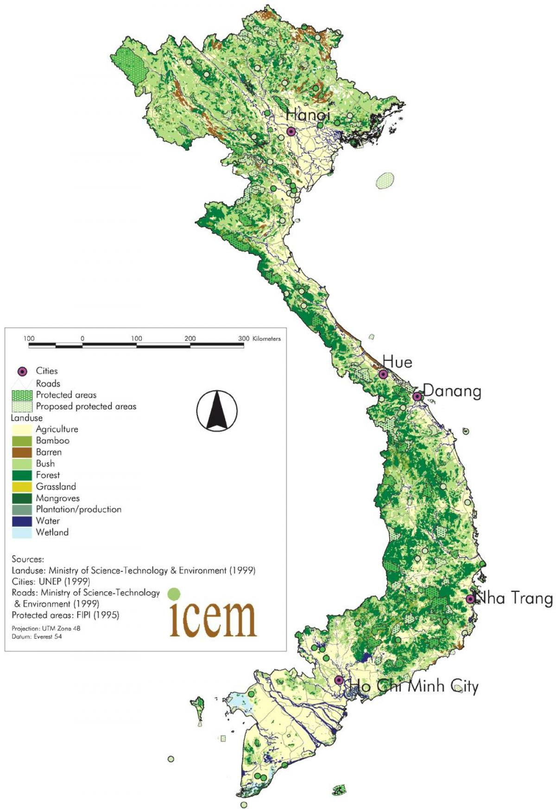
CONTENTS
1. Current status of forests in Vietnam
2. Overview - The role of Vietnam CSOs in climate change response and natural resource management.
3. Status of NbS-related research and practices in Vietnam
4. Recommendations

Slide 3
1. CURRENT STATUS OF FORESTS AND FOREST MANAGEMENT IN VIETNAM
Viet Nam is 1 of the world’s 16 most biologically diverse countries.
Forest area of Vietnam 2020: 14.67 mil., in which: natural forest: 70%; Forest cover rate: 42% (MARD, 2021);
4.64 million ha of protection forest across the whole country (incl. 3.95 mil. ha of natural forest and 0.69 mil. of planted forest);
34 National Parks, 11 world Biosphere Reserves, 09 Ramsar sites and other nature reserves, marine conservation, habitat conservation.
Annual mangrove loss was 0.25% during 2000–2012 (Richards and Friess 2016).
A more cross-sectoral approach to forest protection has emerged, with a shift from traditional and only State funded efforts to stronger involvement from international organizations and the private sector.

Slide 4
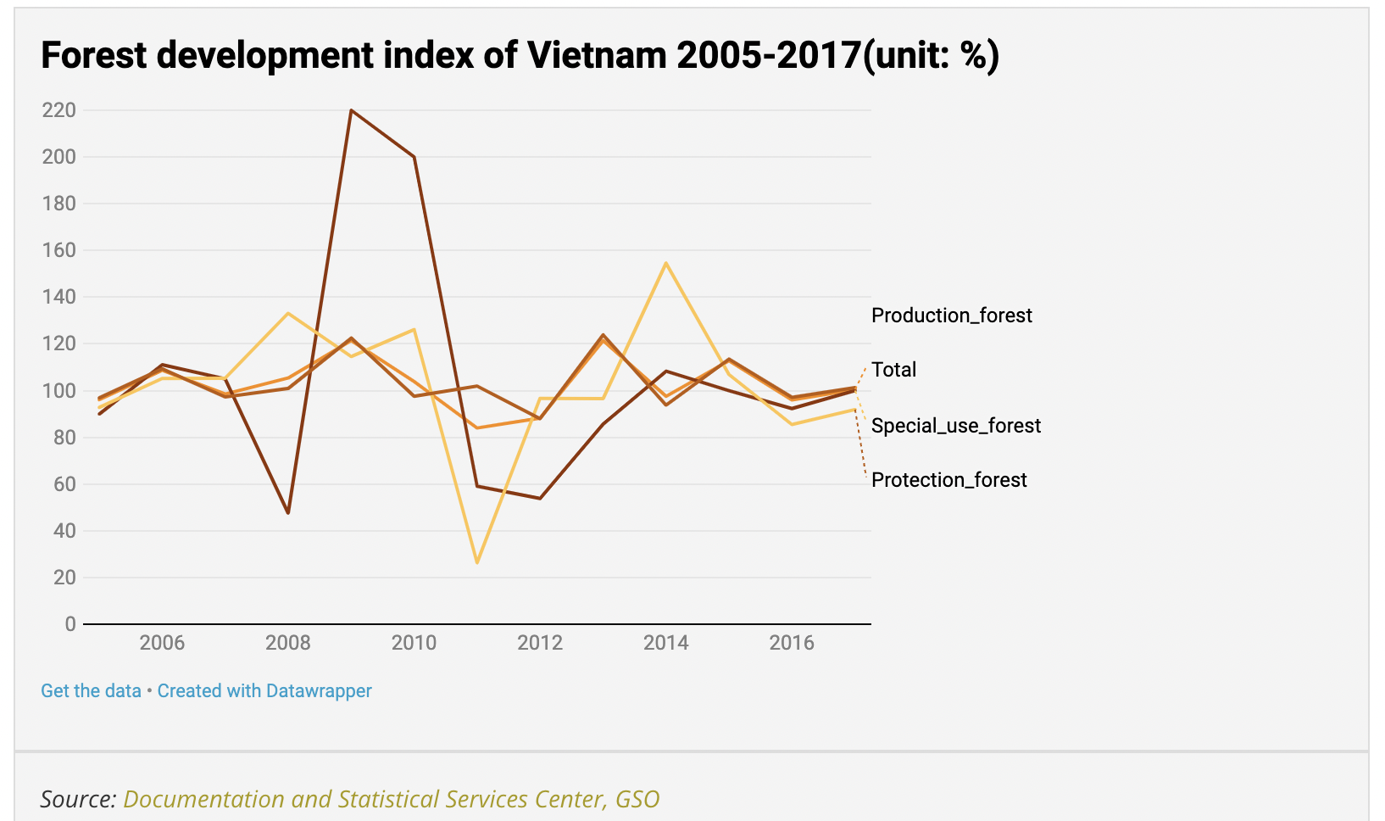

Slide 5
1. CURRENT STATUS OF FORESTS AND FOREST MANAGEMENT IN VIETNAM
POLICY:
Decision No. 120/ QĐ-TTg 2015 on development of coastal forests to cope with climate change during the 2015–2020 period;
National REDD+ Strategy 2017
Forestry Law 2017 (valid from 1/01/2019)
Vietnam’s Nationally Determined Contribution (NDC) (2020)
Environmental Protection Law, 2020
Decree 102 on Vietnam Timber Legality Assurance System (VNTLAS), 2020
VPA FLEGT M&E Framework approved by JIC (focusing on impact monitoring) Nov, 2020
One billion tree planting program issued by the Prime Minister in 2021;
Vietnam Forestry Development Strategy 2021–2030, with vision to 2050.

Slide 6
2. OVERVIEW The role of Vietnam CSOs in climate change response and natural resource management
VNGO-CC: Vietnamese NGO and Climate Change Network of 130 CSOs, SRD is the Chair
CCWG: Climate Change Working Group consists of more than 1,400 subscriber, WWF is the chair and SRD is the co-chair
An Agreement between DCC-VNGO&CC-CCWG was signed since 2011
Regular CCWG’s core group to dialogue with Department of Climate Change (DCC) on NDC and NAP, M&E and gender mainstreaming
CCWG organized NbS training for key I/NGOs members in July
CCWG has reviewed the current strategy to formulate the new one with wider range of interventions including NbS.

Slide 7
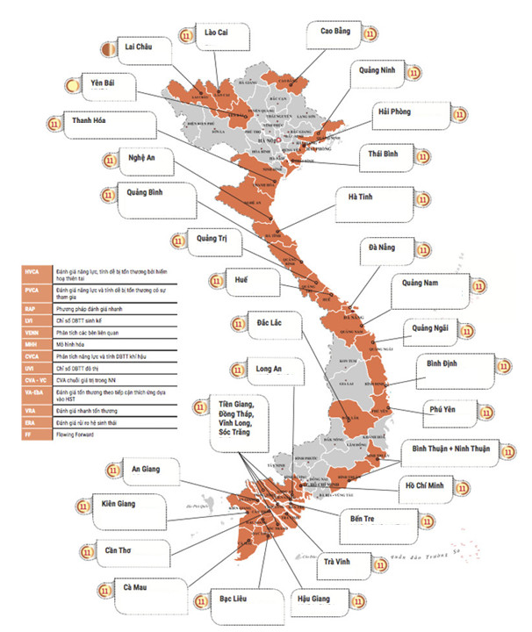
Areas where CSO’ work on climate change are carried out
Covering all climate regions
More focused on ethnic minorities and vulnerable communities:
Northern midland and mountainous areas
Red River Delta
North Central area
South Central Coast
Central Highlands
Mekong River Delta
Large urban areas

Slide 8
3. Status of NbS-related research and practices in Vietnam
Ecosystem-based Approach/ Adaptation (EbA) was first introduced in Vietnam through research in the 1990s, and have the first pilot studies in 2011 -2014 (Ben Tre), 2015-2018 (Quang Binh, Ha Tinh, Hai Phong).
GOV and CSOs’ projects mainly refer to EbA or similar, while NbS is still a new concept;
Viet Nam has submitted the NDC, in which the use of NbS for CC mitigation, includes forest-related mitigation is mentioned
One billion tree planting program issued by the Prime Minister in 2021 to mobilize all stakeholders
Private sector participated largely in production forest management, mainly acacia plantation.

Slide 9
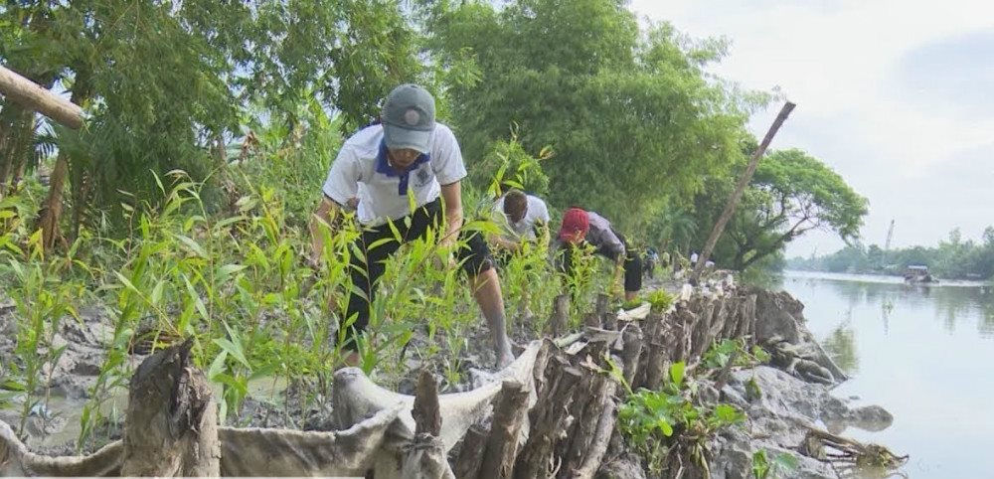
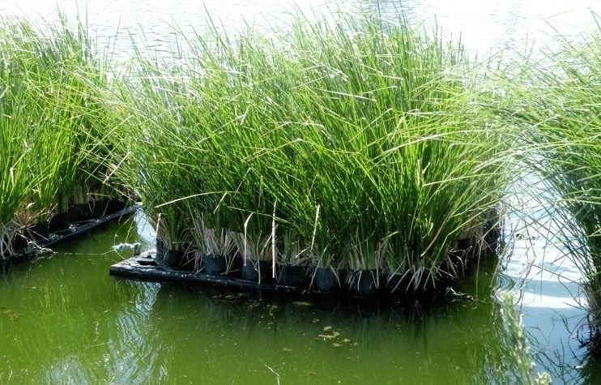
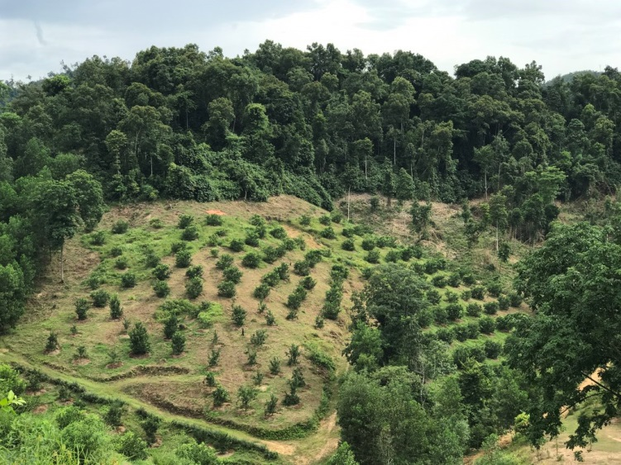
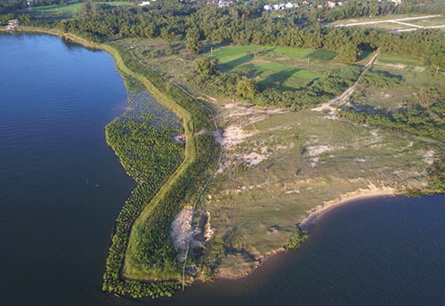
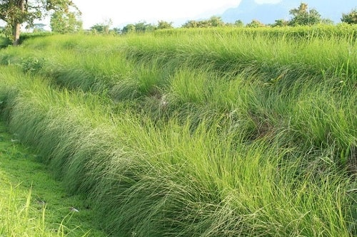
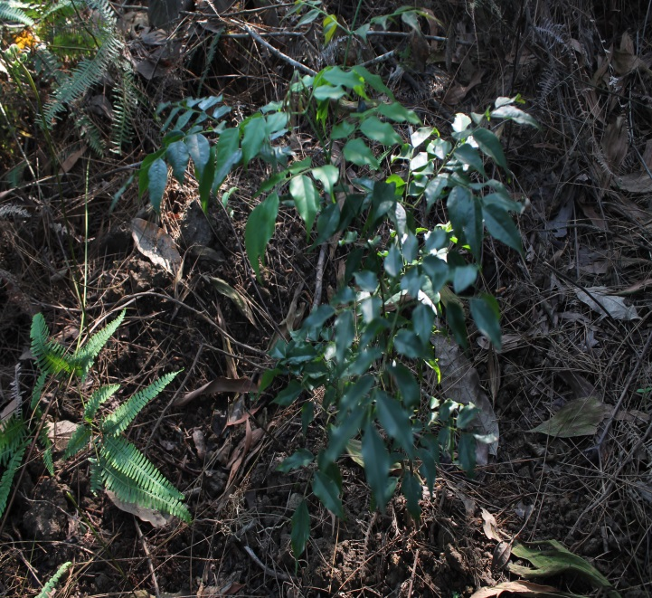
3. Several EbA, NbS related practices in Vietnam
Using Vetiver to reduce the risk of drought and flood, protect infrastructure
Natural forest restoration (planting native trees) combined with land reclamation for livelihoods on sloping land.
Ecological soft embankment to prevent river bank and canal erosion

Slide 10
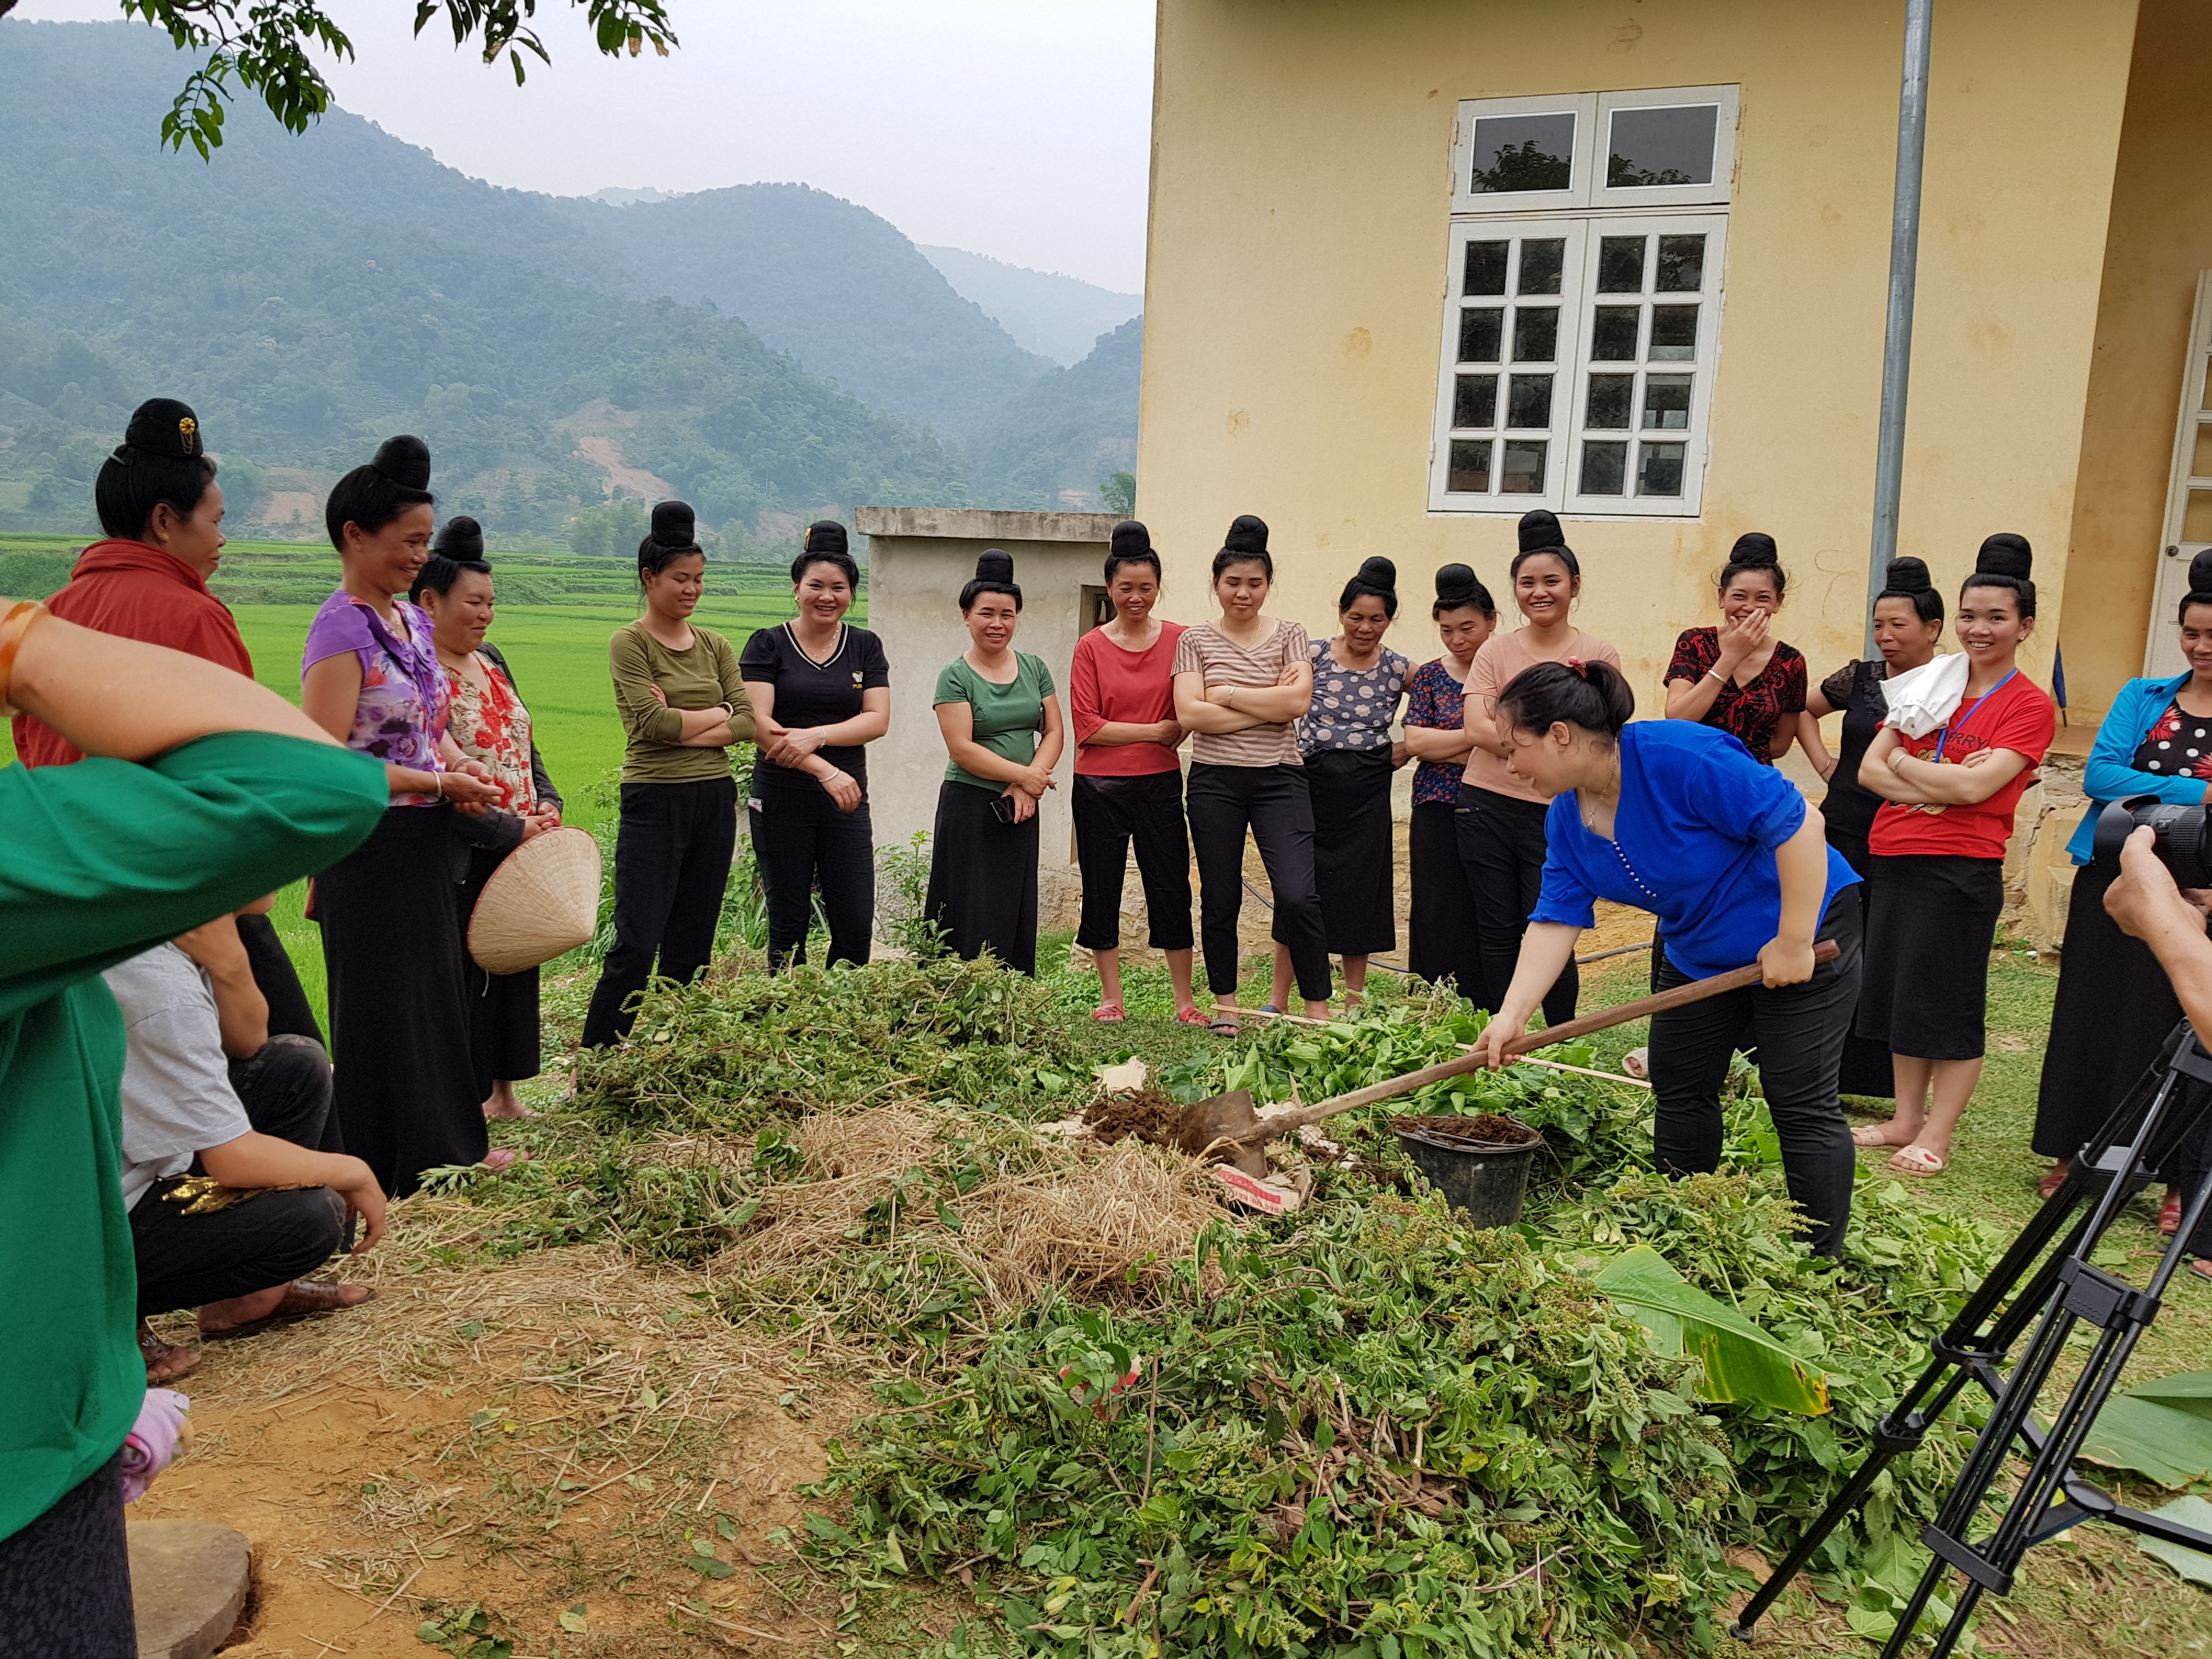
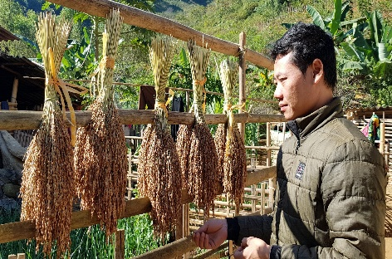
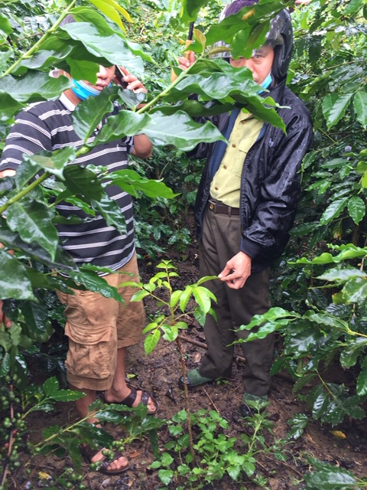
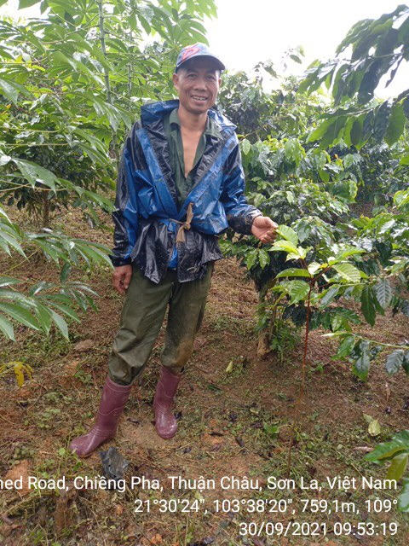
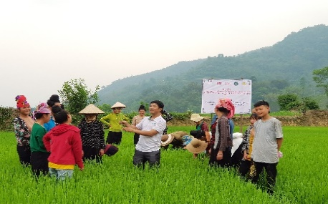
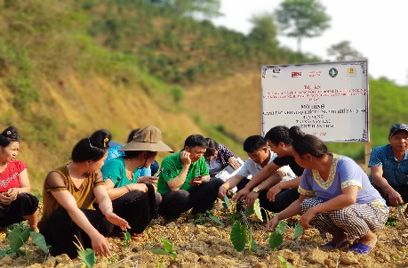
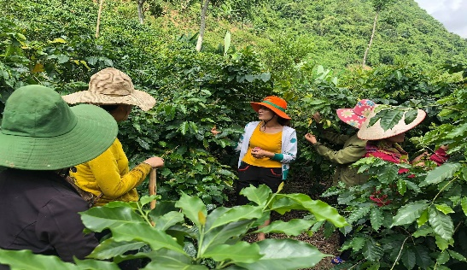
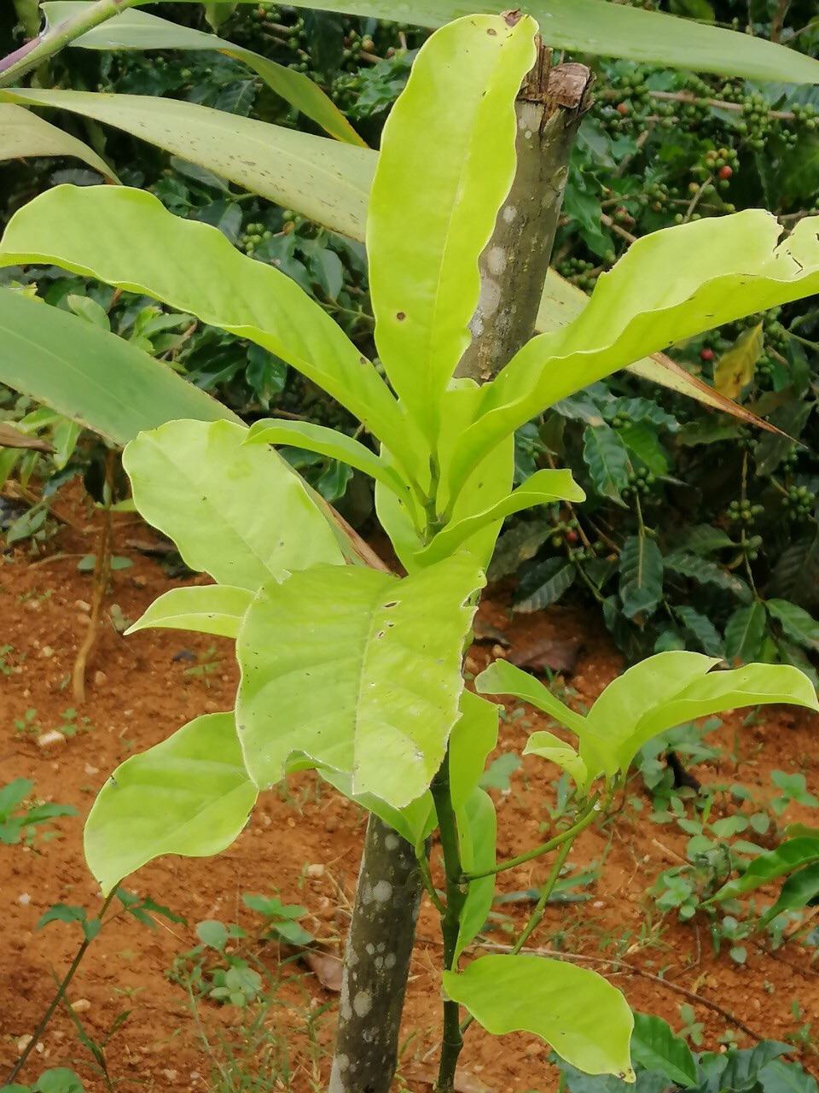
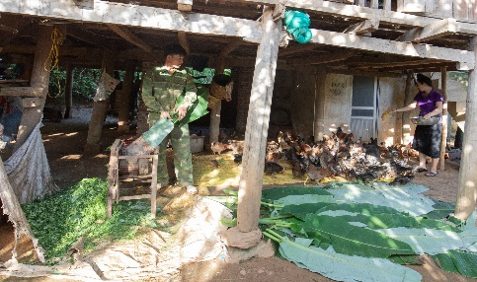
NbS related practices in Vietnam (The experience of SRD)
Promoting the use of manure and compost & IPM for cultivation
Rehabilitating and using the indigenous crops and trees
Developing agro-forestry & native tree planting to reduce soil erosion & drought
Promoting the use of crop by-products for feeding animals

Slide 11
Concerns and potential risks from the application of NbS, EbA in Vietnam
Using NbS, EbA to do economic profit activities: occupying land, destroying forests, privatizing common resources for companies (forests, land, water sources/ river, lake, sea)
Occupying forest land, nature conservation areas in the name of eco-tourism, eco-agro-forestry tourism in mountainous and coastal localities
Privatization of forest areas and reduces access to land and forest resources of local communities
The misconception that NbS is a substitute for rapid phase-out of fossil fuels
No of incidences of natural forest illegal logging for timbers and land
Forest land conversion to other purposes (encroachment, agriculture expansion, ecotourism, infrastructure,…).

Slide 12
4. Key recommendations
NbS should be clearly defined in the context of NDC and NAP
Support for conducting evidence-based studies on the current state of NbS in Vietnam (focus on good practices and land-grabbing under the name of conservation)
Strengthen communication and training on NbS, EbA and proper use of NbS in the implementation of economic growth
NbS must contribute directly to co-benefits for human wellbeing at the national and local level
Strengthen the capacity of CSO, local governments and communities on NbS, EbA implementation and M&E.

Slide 13
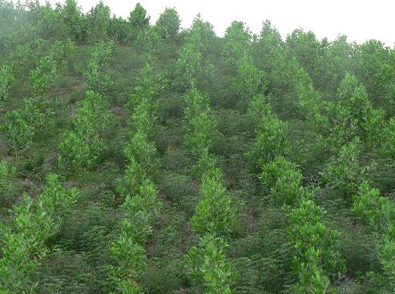
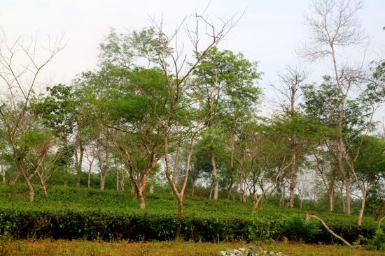
Thank you for your attention!
The Center for Sustainable Rural Development (SRD)
56 lane 19/9, Kim Dong street, Ha Noi
Tel: (84) 4 39436676/78 Fax: 04 39436449
Email: info@srd.org.vn
Website: www.srd.org.vn
Center for Eco-Community Development (ECODE)
101 – B6 Khuong Trung street, Thanh Xuan dist., Ha Noi
Tel: (84) 4 02435747837 Email: ecode.vietnam@gmail.com
Website: www.srd.org.vn

